Slide 1
Loan Approval Prediction
Group 18
Kothapalli Bhuvana Chandrika (bk24542)
Spandan Pal (sp54969)
John Hwang (jh75576)
Mansi Sharma (ms89743)
Serena Song (fs9589)

Slide 2
Table of contents
01
04
02
05
03
Introduction
Modeling
Exploratory
Data Analysis
Conclusion
Feature Engineering

Slide 3
01
Introduction

Slide 4
Introduction and Objective
Introduction
Objectives
The dataset has been obtained from Kaggle.
Accurate and faster loan approval processes can
Reduce risk of financial institutions for granting loans
Streamline operation in the loan evaluation process
Our goal here is to predict the loan approval of an applicant.
Here, we will try to determine the factors that influence the loan approval status .
We will also different models to determine the best possible predictions.
Based on this, we will try to make recommendations for the same.

Slide 5
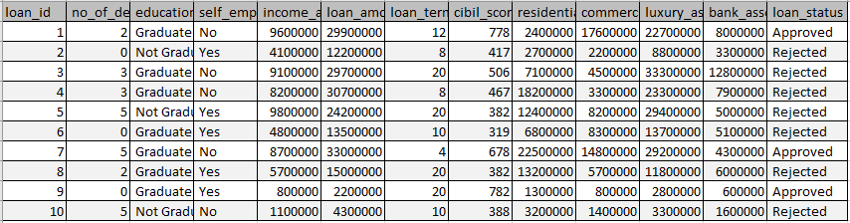
Dataset Overview
Data Snapshot
Metadata
Loan id
No of Dependents
Educational Status
Self Employment Status
Income Per Annum
Loan Amount
Loan Term
Cibil Score
Residential Assets Value
Commercial Assets Value
Luxury Assets Value
Bank asset value
Loan Status
Note:
CIBIL Score is a 3-digit numeric summary of your credit history and ranges from 300 to 900. The closer your score is to 900, the better your credit rating is.

Slide 6
02
Exploratory Data Analysis

Slide 7
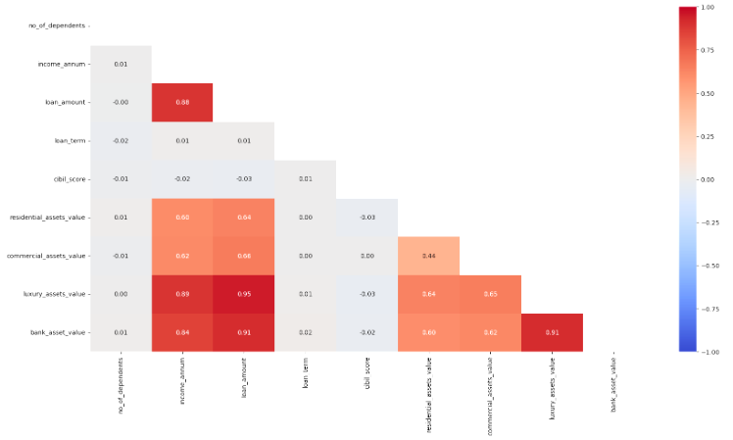
Exploratory Analysis - Numerical Variables
Correlation Matrix
Key Observations
loan_amount + income_annum
income_annum + luxury_assets_value
income_annum + bank_asset_value
loan_amount + luxury_assets_value
loan_amount + bank_asset_value
bank_asset_value + luxury_assets_value
Note:
Due to the skewed distribution of variables like loan_amount, commercial_asset_value etc, the log transformation of the variables were considered here.
Point to note: We do not see any correlation between the CIBIL score and any other variable

Slide 8
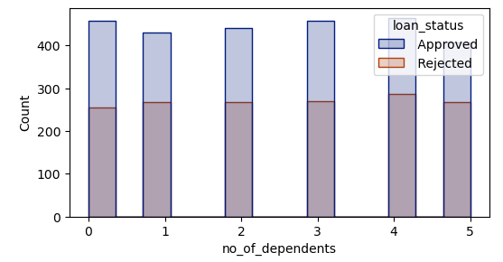
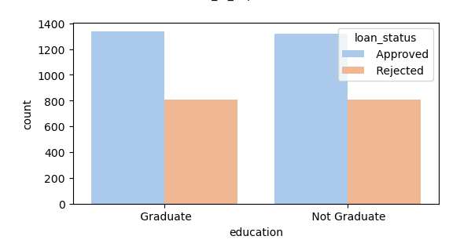
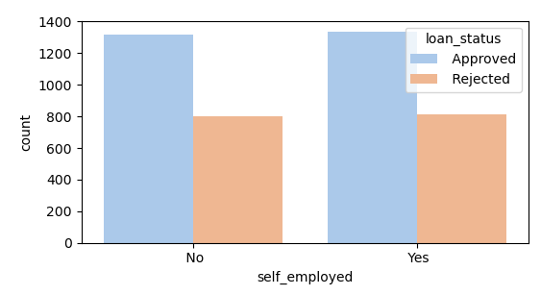
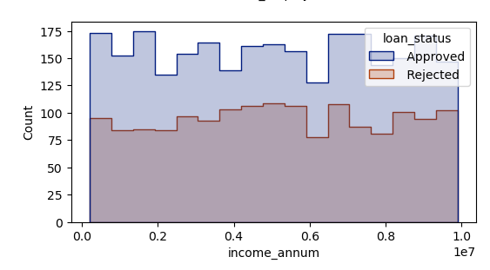
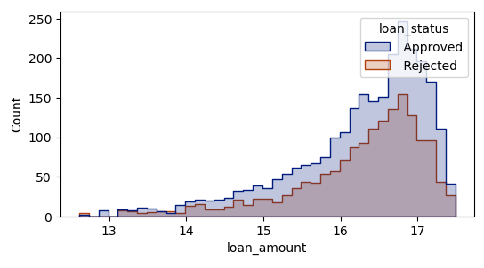
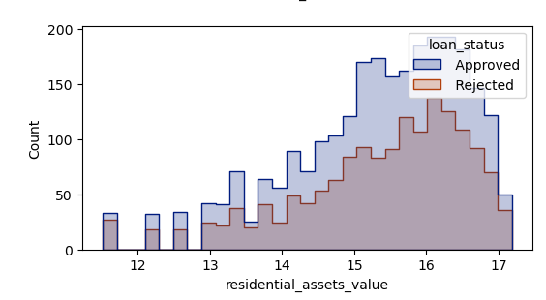
Exploratory Analysis - Predictors vs Loan Status
No of dependents vs Loan status
Education vs Loan status
Self Employed vs Loan status
No of dependents seem to have no impact on loan status
Education seem to have no impact on loan status
Self Employed Status seem to have no impact on loan status
Income Annum vs Loan status
Loan Amount vs Loan status
Residential Asset vs Loan status
Annual Income seem to have no impact on loan status
Loan Amount seem to have no impact on loan status
Residential Asset Value seem to have no impact on loan status

Slide 9
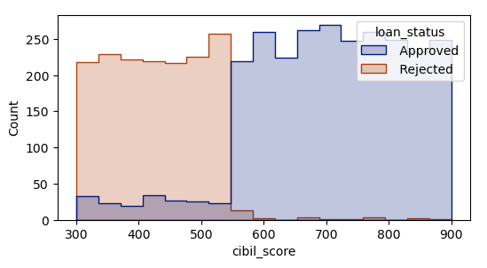
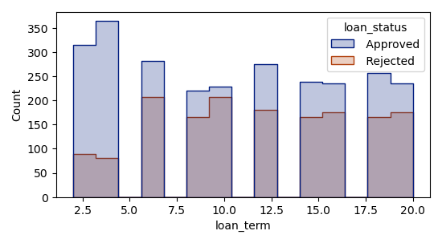
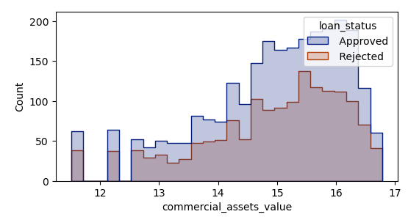
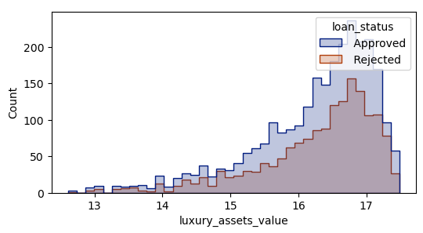
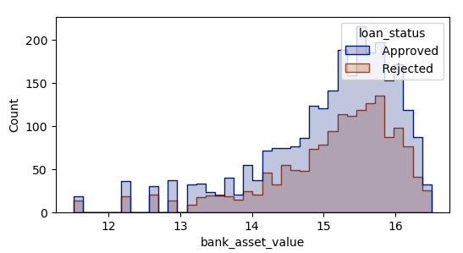
Exploratory Analysis - Predictors vs Loan Status (Contd)
CIBIL Score vs Loan status
Loan Term vs Loan status
Commercial Asset vs Loan status
If CIBIL Score is above a certain value, then chances of loan approval increases significantly
As Loan Term increases, the chances of Loan Rejection increases
Commercial Asset Value seem to have no impact on loan status
Luxury Asset vs Loan status
Bank Asset vs Loan status
Key Takeaway Point
Loan Term seems to have an impact on the loan approval status.
CIBIL Score seems to have an impact on the approval status
Note: Looking at the distribution of Approval and Rejects in the dataset, the baseline accuracy for anu model should be 62%.
Luxury Assets Value seem to have no impact on loan status
Bank Asset Value seem to have no impact on loan status

Slide 10
03
Feature Engineering

Slide 11
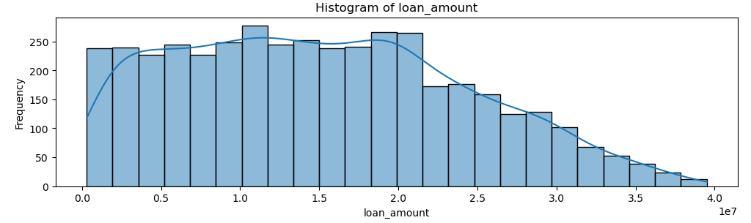
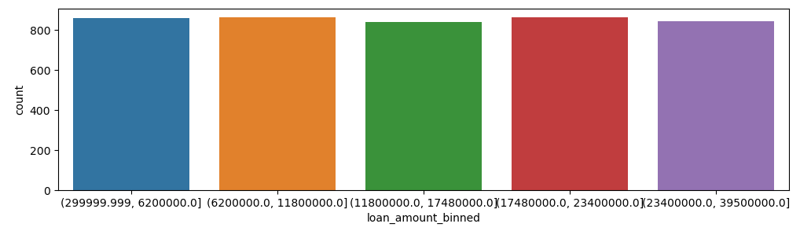
Feature Engineering
Bucketing of Continuous Variables
Before Transformation
After Transformation
For the variables such as Loan Amount, Residential Assets Value, Commercial Assets Value, the distribution is right skewed. So, we segment the variables into bins for future analysis.
2. Removal of Unnecessary Variables
Loan ID | No business value since system field
Luxury Assets Value, Bank Asset Value | Fields have a high correlation with other fields - Loan Amount and Income Amount

Slide 12
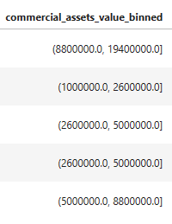
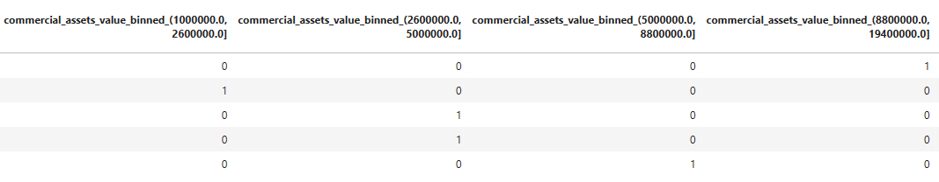
Feature Engineering
3. One Hot Encoding
Before Transformation
After Transformation
For variables like Education, Self Employed, commercial assets value binned etc, each categorical value is converted into a new categorical column with the binary value of a 0 or 1.
4. Variable Scaling using Z-scale Normalization
Numerical Variables such as Loan Amount are standardized to have a zero mean and unit standard deviation
The numerical values are scaled as per z = ( x - mean) / standard_deviation. This is done to bring all the features to a similar scale, so that they contribute equally to the analysis.

Slide 13
04
Modeling

Slide 14
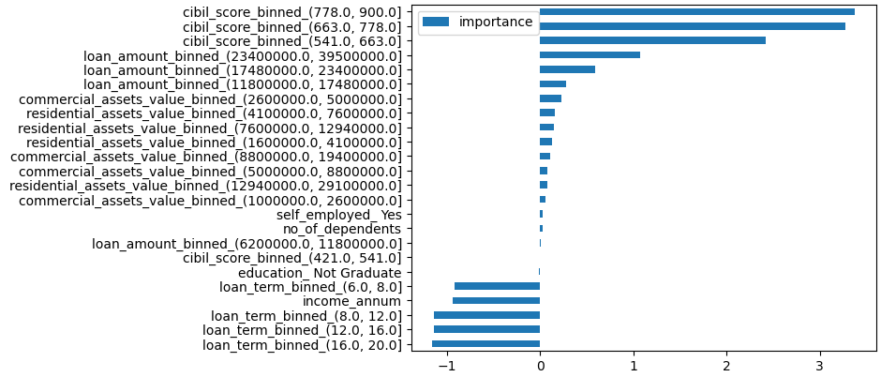
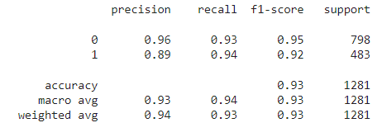

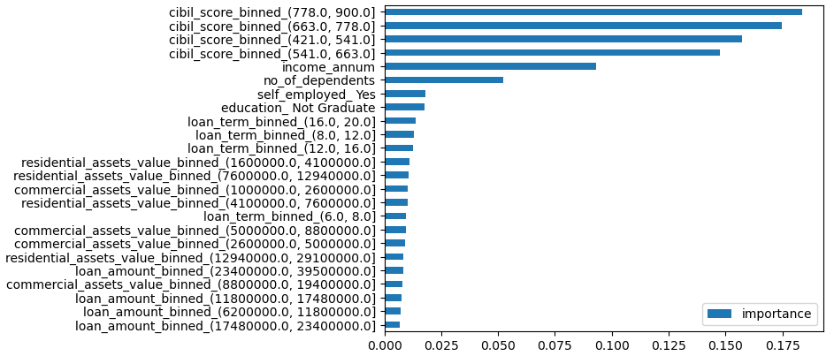
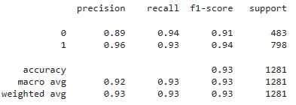

Modeling
Logistic Regression |  | The time to run the Logistic Regression model is 0.137 seconds.
Decision Tree
The AUC for Logistic Regression is : 0.935300
The time to run the Logistic Regression model is 0.137 seconds.
CIBIL score of 540+ is most significant in the approval of the loan.
Loan Term negatively affects the Loan Approval Status. This is in alignment with our exploratory analysis.
T
The AUC for Decision Tree is : 0.93404
The time to run the Decision Tree model is 0.13869 seconds.
Decision Tree also lists Annual Income, no_of_dependents. This is not aligned with the initial analysis.

Slide 15
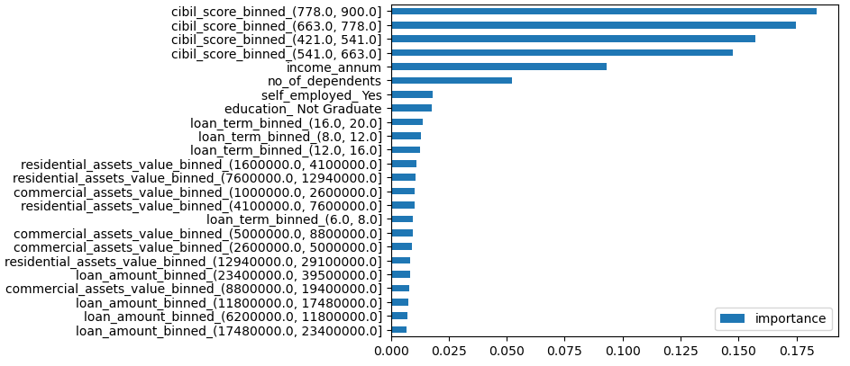
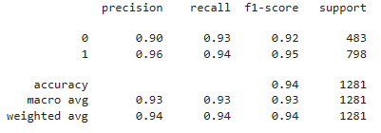

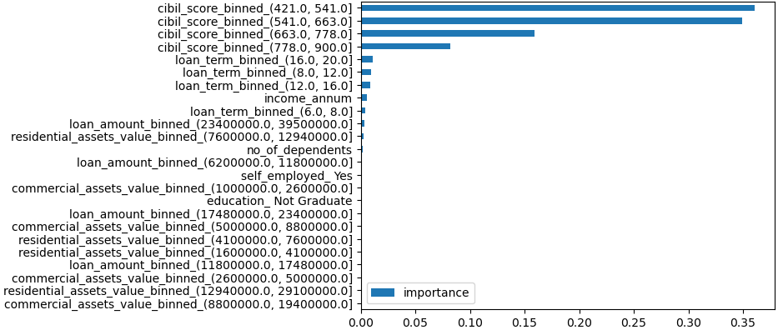
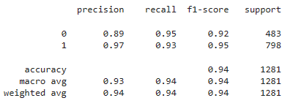

Modeling
Random Forest
Gradient Boosting
The AUC for Random Forest is : 0.93451
The time to run the Random Forest model is 0.699 seconds.
Similar to Decision Tree, Random Forest also considers annual income, no of dependents, self employed, education along with CIBIL Score and Loan Term as the most significant indicators.
The AUC for Gradient Boosting is : 0.94028
The time to run the Gradient Boosting model is 1.880 seconds.
Gradient Boosting only considers CIBIL Score and Loan Term as the significant features.

Slide 16
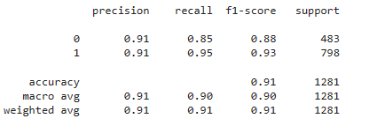

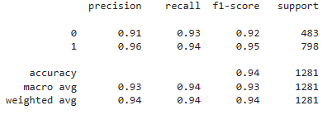

Modeling
K Nearest Neighbours
Neural Network
Key Takeaway Points
Neural Network has the highest AUC at 98%. However, it also has the greatest run-time compared to all the models.
CIBIL Score and Loan Term are the most important predictors. Following this, features like education, self employed, loan amount and no of dependents also have some significance.
The AUC for KNN is : 0.89977
The time to run the KNN model is 0.179 seconds.
The AUC for NN is : 0.98242
The time to run the NN model is 2.88 seconds.

Slide 17
05
Conclusion

Slide 18
Conclusion
Model Type | Accuracy (%) | F-1 Score |  | Run Time (Secs)
 |  | Approval | Rejection
Logistic Regression | 93 | 0.92 | 0.95 | 0.137
Decision Tree | 93 | 0.94 | 0.91 | 0.139
Random Forest | 94 | 0.95 | 0.92 | 0.699
Gradient Boosting | 94 | 0.95 | 0.92 | 1.880
KNN | 91 | 0.93 | 0.88 | 0.179
Neural Network | 98 | 0.95 | 0.92 | 2.88

Slide 19
Observations and Recommendations
01 | CIBIL Score or the Credit Score is the most important predictor for the loan approval status. It has been seen that a CIBIL score > 540 significantly increases the chances of loan approval. This is in alignment with EDA.
02 | Loan Term is also an important predictor for loan approval status. It has a negative relationship with the chances of loan approval i.e. it the loan term increases then the chances of approval decreases. This is in alignment with EDA.
03 | Factors like education, self employed,were initially not considered to be significant during Exploratory Data Analysis. But, the machine learning algorithm reveals that these factors are significant. This is most probably due to the interaction with other variables.
04 | Neural Network gives the best accuracy with this data set. It has also been tested that using Neural Network with a selected list of only significant predictors gives an AUC score of 97.8%. If all the predictors had been selected the AUC score was seen to be 98.2%. Thus, there is no major drop in accuracy if we use only the significant indicators.

Slide 20
Thanks!
Do you have any questions?

